Slide 1
MIS
CHAPTER 6
DATA COMMUNICATION: DELIVERING INFORMATION ANYWHERE AND ANYTIME
Hossein BIDGOLI

Slide 2
Chapter 6 Data Communication: Delivering Information Anywhere and Anytime
l e a r n i n g o u t c o m e s
LO1 Describe major applications of data communication systems.
LO2 Explain the major components of a data communication system.
LO3 Describe the major types of processing configurations.
LO4 Explain the three types of networks.
LO5 Describe the main network topologies.

Slide 3
Chapter 6 Data Communication: Delivering Information Anywhere and Anytime
l e a r n i n g o u t c o m e s (cont’d.)
LO6 Explain important networking concepts, such as bandwidth, routing, routers, and the client/server model.
LO7 Describe wireless and mobile technologies and networks.
LO8 Discuss the importance of wireless security and the techniques used.
LO9 Summarize the convergence phenomenon and its applications for business and personal use.

Slide 4
Defining Data Communication
Data communication
  Electronic transfer of data from one location to another
  Enables an information system to deliver information
  Improves the flexibility of data collection and transmission
  Basis of virtual organizations
  Provides e-collaboration

Slide 5
Why Managers Need to Know About Data Communication
Separating an organization’s core functions from the data communication systems that enable and support them is difficult
Enhances decision makers’ efficiency and effectiveness
Enables organizations to use e-mail and electronic file transfer to improve efficiency and productivity
Highlights how data communication technologies are used in the workplace

Slide 6
Why Managers Need to Know About Data Communication (cont’d.)
Important concepts:
  The basics of data communication and networking
  The Internet, intranets, and extranets
  Wired and wireless networks
  Network security issues and measures
  Organizational and social effects of data communication
  Globalization issues
  Applications of data communication systems

Slide 7
Basic Concepts in a Data Communication System
Bandwidth
  Amount of data that can be transferred from one point to another in a certain time period
Attenuation
  Loss of power in a signal as it travels from the sending device to the receiving device
Broadband data transmission
  Multiple pieces of data are sent simultaneously to increase the transmission rate

Slide 8
Basic Concepts in a Data Communication System (cont’d.)
Narrowband
  Voice-grade transmission channel capable of transmitting a maximum of 56,000 bps, so only a limited amount of information can be transferred
Protocols
  Rules that govern data communication, including error detection, message length, and transmission speed

Slide 9
Sender and Receiver Devices
Device can be one of the following:
  “Thin client”
  Smart terminal
  Intelligent terminal
  Netbook
  Other types of computers
  Smartphones, mobile phones, mp3 players, PDAs, game consoles

Slide 10
Modems
Modem (short for “modulator-demodulator”)
  Device that connects a user to the Internet
  Not required for all Internet connections
Types
  Dial-up (analog)
  Digital subscriber line (DSL)
  Cable

Slide 11
Communication Media
Communication media
  Also called channels
  Connect sender and receiver devices
Conducted media
  Provide a physical path along which signals are transmitted
  Include twisted-pair cable, coaxial cable, and fiber optics

Slide 12
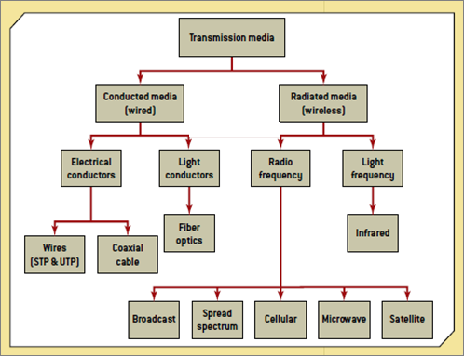
Exhibit 6.1
Types of Communication Media

Slide 13
Communication Media (cont’d.)
Radiated media
  Use an antenna for transmitting data through air or water
  Some work based on “line of sight”
  Include broadcast radio, terrestrial microwave, and satellite
Types
  Point-to-point
  Multipoint system

Slide 14
Processing Configurations
Data communication systems can be used in several different configurations
Over past 60 years, three types of processing configurations have emerged:
  Centralized
  Decentralized
  Distributed

Slide 15
Centralized Processing
Centralized processing system
  Processing is done at one central computer
Advantage
  Being able to exercise tight control on system operations and applications
Disadvantage
  Lack of responsiveness to users’ needs
Not commonly used

Slide 16
Decentralized Processing
Decentralized processing
  Each user, department, or division has its own computer for performing processing
Advantage
  More responsive to users
Disadvantages
  Lack of coordination
  High costs
  Duplication of efforts

Slide 17
Distributed Processing
Distributed processing
  Centralized control and decentralized operations
Advantages
  Accessing unused processing power is possible
  Computer power can be added or removed
  Distance and location aren’t limiting
  More compatible with organizational growth
  Fault tolerance
  Resources can be shared to reduce costs
  Reliability is improved
  More responsive to user needs

Slide 18
Distributed Processing (cont’d.)
Disadvantages
  Dependence on communication technology
  Incompatibility between equipment
  More challenging network management

Slide 19
Open Systems Interconnection Model
Seven-layer architecture for defining how data is transmitted
Layers:
  Application
  Presentation
  Session
  Transport
  Network
  Data link
  Physical

Slide 20
Types of Networks
Three major types of networks:
  Local area networks, wide area networks, and metropolitan area networks
Network interface card (NIC)
  Hardware component that enables computers to communicate over a network
Common types of local area networks:
  Ethernet and token ring
Network operating system (NOS) must be installed

Slide 21
Local Area Networks
Connect workstations and peripheral devices that are in close proximity
Limited geographical area
Data transfer speed varies from 100 Mbps to 10 Gbps
Purpose to share resources
Key terms:
  Ethernet and Ethernet cable

Slide 22
Wide Area Networks
Span several cities, states, or even countries
Owned by different parties
Data transfer speed: 28.8 Kbps to 155 Mbps
Use many different communication media
Connect to other networks

Slide 23
Metropolitan Area Networks
Communication for multiple organizations in a city and sometimes nearby cities
Data transfer speed varies from 34 Mbps to 155 Mbps

Slide 24
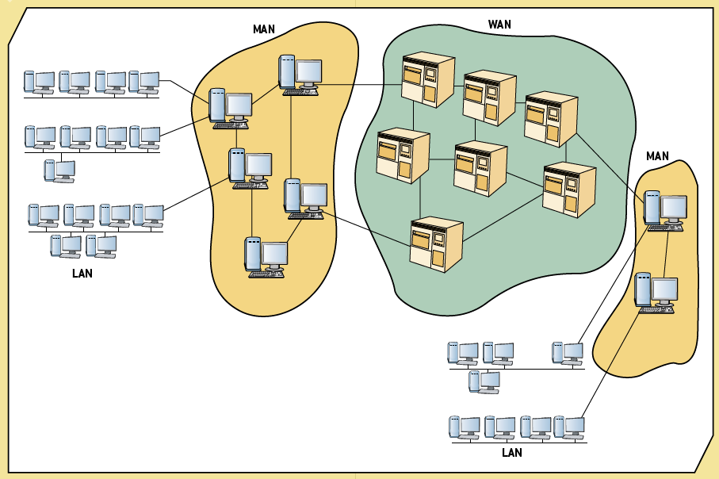
Exhibit 6.4
Metropolitan Area Networks

Slide 25
Network Topologies
Represent a network’s physical layout
Five common topologies:
  Star
  Ring
  Bus
  Hierarchical
  Mesh

Slide 26
Star Topology
Central computer and a series of nodes
Advantages
  Cable layouts are easy to modify
  Centralized control makes detecting problems easier
  Nodes can be added to the network easily
  Better for handling heavy but short bursts of traffic
Disadvantages
  Single point of potential failure
  Increased cost due to many cables

Slide 27
Ring Topology
Each computer manages its own connectivity
Each node is connected to two other nodes
  Upstream neighbor and downstream neighbor
Transmission in one direction
Implementations
  Token ring
  Fibre Distributed Data Interface (FDDI)
Needs less cable than star
Handles heavy short bursts well

Slide 28
Bus Topology
Connects nodes along a network segment
  Ends of the cable aren’t connected
  Terminator absorbs signal at each end
Most commonly used speeds:
  1, 2.5, 5, 10, and 100 Mbps, with 10 Mbps, 100 Mbps, 1 Gbps, and 10 Gbps (Gigabit Ethernet)

Slide 29
Bus Topology (cont’d.)
Advantages
  Easy to extend
  Very reliable
  Wiring layout is simple and uses the least amount of cable of any topology
  Best for handling steady (even) traffic
Disadvantages
  Fault diagnosis is difficult
  Bus cable can be a bottleneck when network traffic is heavy

Slide 30
Hierarchical Topology
Combines computers with different processing strengths in different organizational levels
Traditional mainframe networks
Controller
  Hardware and software device that controls data transfer from a computer to a peripheral device
Multiplexer
  Hardware device that allows several nodes to share one communication channel

Slide 31
Hierarchical Topology (cont’d.)
Advantages
  Network control
  Lower costs
Disadvantages
  Expansion may be a problem
  Traffic congestion at root and higher-level nodes

Slide 32
Mesh Topology
Every node is connected to every other node
Advantages
  Highly reliable
Disadvantages
  Costly
  Difficult to maintain
  Difficult to expand

Slide 33
Major Networking Concepts
Important networking concepts:
  Protocols
  TCP/IP
  Routing
  Routers
  Client/server model

Slide 34
Protocols
Agreed-on methods and rules that electronic devices use to exchange information
Deal with hardware, software, and networking
Multiple protocol support is important

Slide 35
Transmission Control Protocol/Internet Protocol
Industry-standard suite of communication protocols
Main advantage is that it enables interoperability
Originally intended for Internet communication
Major protocols in the TCP/IP suite:
  Transmission Control Protocol (TCP)
    Operates at the OSI model’s Transport layer
  Internet Protocol (IP)
    Operates at the OSI model’s Network layer

Slide 36
Routing
Packet
  Collection of binary digits, including message data and control characters for formatting and transmitting
  Sent from computer to computer over a network
Routing
  Process of deciding which path data takes
  Decisions made using routing table
  Centralized routing
  Distributed routing

Slide 37
Routers
Network connection device containing software
Connects network systems and controls traffic flow between them
Must use a common routing protocol
Operates at network layer
Performs the same functions as a bridge
  More sophisticated device
Chooses the best possible path for packets
Static and dynamic routers

Slide 38
Client/Server Model
Software runs on the local computer (the client)
  Communicates with the remote server to request information or services
Server
  Remote computer on the network that provides information or services in response to client requests
Basic client/server communication
Advantage: scalability
Three levels of logic: presentation, application, data management

Slide 39
Two-Tier Architecture
Traditional client/server model
  Client communicates directly with the server
Presentation logic is always on the client
Data management logic is on the server
Application logic located on either or both
Effective in small workgroups

Slide 40
N-Tier Architectures
Balance the workload between client and server
Removes application processing from both the client and server
  Places it on a middle-tier server
Three-tier
  Most common n-tier architecture
Advantage
  Improved network performance
Disadvantage
  Network management more challenging

Slide 41
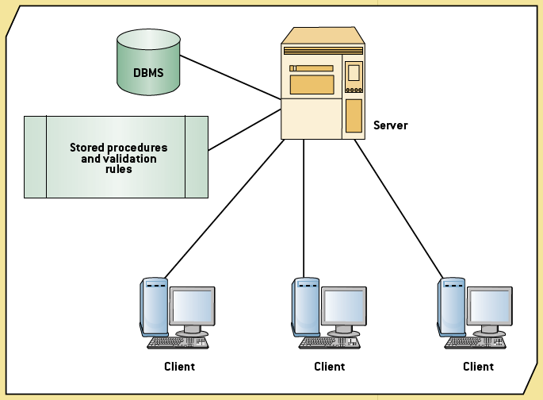
Exhibit 6.6
A Two-Tier Client/Server Architecture

Slide 42
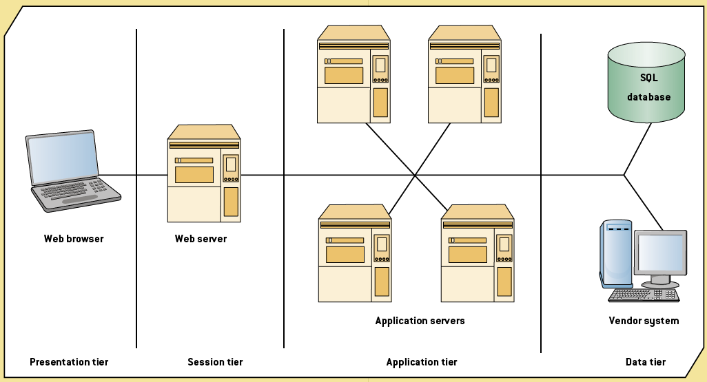
Exhibit 6.7
An N-Tier Architecture

Slide 43
Wireless and Mobile Networks
Wireless network
  Uses wireless instead of wired technology
Mobile network
  Network operating on a radio frequency (RF), consisting of radio cells served by a base station
Advantages
  Mobility, flexibility, ease of installation, low cost
Disadvantages
  Limited throughput and range, in-building penetration problems, vulnerability to frequency noise, security

Slide 44
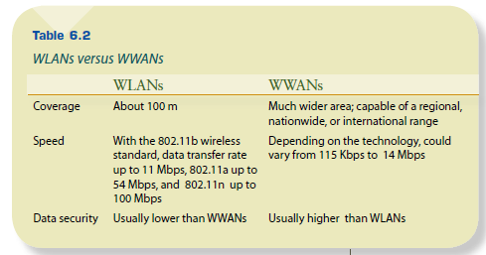
Wireless Technologies
Groups
  Wireless LANs
  Wireless WANs

Slide 45
Mobile Networks
Three-part architecture
  Base stations
  Mobile telephone switching offices (MTSOs)
  Mobile communication devices
Technologies
  Time Division Multiple Access (TDMA)
  Code Division Multiple Access (CDMA)

Slide 46
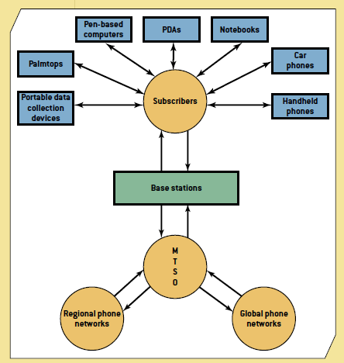
Exhibit 6.10
Mobile Network Architecture

Slide 47
Wireless Security
Security is especially important in a wireless network, since anyone walking or driving within the range of an AP (even outside a home or office) can use the network
A user can simply walk or drive around office buildings or homes with a WLAN-equipped computer and try to pick up a signal

Slide 48
Techniques for Improving the Security of a Wireless Network
SSID (Service Set Identifier)
All client computers that try to access the AP are required to include a SSID in all of their packets
A packet without a SSID is not processed by the AP

Slide 49
Techniques for Improving the Security of a Wireless Network (cont’d.)
WEP (Wired Equivalent Privacy)
A key must be manually entered into the AP and the client computer
The key encrypts the message before transmission

Slide 50
Techniques for Improving the Security of a Wireless Network (cont’d.)
EAP (Extensible Authentication Protocol)
WEP keys are dynamically generated based on the user’s ID and password
When the user logs out of the system, the key is discarded
A new key is generated when the user logs back into the network
EAP (Extensible Authentication Protocol)
WEP keys are dynamically generated based on the user’s ID and password
WPA (Wi-Fi Protected Access)—This technique combines the strongest features of WEP and EAP: Keys are fixed, as in WEP, or dynamically changed, as in EAP.

Slide 51
Techniques for Improving the Security of a Wireless Network (cont’d.)
WPA (Wi-Fi Protected Access)
Combines the strongest features of WEP and EAP
However, the WPA key is longer than the WEP key; therefore, it is more difficult to break
The key is changed for each frame before transmission

Slide 52
Techniques for Improving the Security of a Wireless Network (cont’d.)
WPA2 or 802.11i
It uses EAP to obtain a master key
With this master key, a user’s computer and the AP negotiate for a key that will be used for a session
After the session is terminated, the key is discarded

Slide 53
Convergence of Voice, Video, and Data
Convergence
  Integrating voice, video, and data so that multimedia information can be used for decision making
Integrating video with voice and data required network upgrades
Common applications:
  E-commerce
  Entertainment
  Video and computer conferencing
  Consumer applications

Slide 54
Summary
Data communication systems:
  Basic components
  Processing configurations
  Types of networks
  Network topologies
  Important concepts
Wireless and mobile networks
Wireless security
Future trends in data communication:
  Convergence and telepresence

